Slide 1
CORROSION
Chapter – 4
Lecture - 1

Slide 2
CONTENTS
Introduction
Facts
Theories
Types
Consequences
Factors
Prevention

Slide 3
CORROSION
The loss of materials(metal and alloys) or its useful properties, by chemical or electrochemical interaction with its environment is called corrosion.
Deterioration of material when exposed environment
Example:
Rusting of iron
formation of green layer on copper surface.

Slide 4
Corrosion Engineering
Branch of Engineering dealing with the study of corrosion mechanisms and to prevent or control it economically and safely.

Slide 5
FACTS ABOUT CORROSION
Natural process.
Electrochemical process.
Leads to tremendous loss.
Can’t be eliminated completely, only extent can be minimized.
Reverse of extraction of metals.
Also known as ‘weeping of metals’.

Slide 6
CAUSE OF CORROSION
Metal Metal salt
(higher energy state) (lower energy state)

Slide 7
THEORIES OF CORROSION
1. Direct chemical attack theory (Chemical corrosion or dry corrosion)
2. Wet or electrochemical corrosion (Electrochemical theory)
3. Acid theory

Slide 8
Direct chemical attack theory (Chemical corrosion or dry corrosion)
Corrosion by O₂
Corrosion by other gases
Liquid metal corrosion

Slide 9
Oxidation Corrosion
2M 2M^{n+} + 2ne⁻ (oxidation)
n/2O₂ + 2ne⁻ nO²⁻ (reduction)
2M + n/2O₂ 2M^{n+} + nO²⁻
^{Metal oxide}

Slide 10
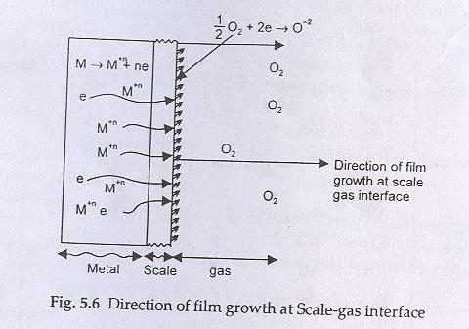
Case I: When metal ion diffuses faster outward:
In this case oxide layer is formed at the metal oxide – gas or scale – gas interface.e.g. In FeO, CoO, NiO, Cu₂O

Slide 11
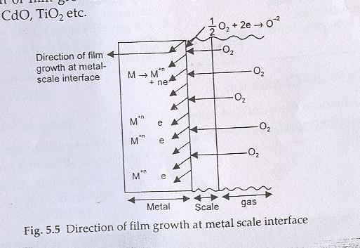
Case II: When oxygen diffuses inward:
In this case oxide layer is formed at the metal- scale interface or metal – metal oxide interface. e.g in ZnO, CdO, TiO₂ etc

Slide 12
Nature of metal oxide layer
^{a) Stable film –}An impervious layer is formed, which checks further oxidation corrosion.
^{e.g.} oxide films on Al, Sn, Pb, Cu etc.
b) Unstable film-
Metal oxide Metal + O₂
O₂ Metal oxide
decomposes
e.g. in Au and Ag

Slide 13
c) Volatile film- oxide layer volatilizes leaving the underlying metal surface for further attack. E.g. molybdenum oxide (MoO₃) is volatile.
O₂ metal oxide
volatilizes
d) Porous film- atmospheric O₂ have access to the
underlying surface of metal.

Slide 14
Pilling Bedworth rule
If Volume of metal oxide ≥ volume of metal
Oxide layer is protective or non-porous
e.g. Al
If Volume of metal oxide < volume of metal
Oxide layer is porous
e.g. Alkali and alkaline earth metals
ii) Corrosion by other gases- by CO₂, SO₂,Cl_{2,}H₂S,
etc
Extent of corrosion depends upon the chemical affinity between metal and the gas involved and the nature of the film formed on the surface.

Slide 15
protective or non-porous.
E.g. AgCl layer formed by the attack of
Cl₂ on Ag
Film
non-protective or porous.
E.g. i) formation of volatile SnCl₄ by the
attack of dry Cl₂ on Sn.
ii) in petroleum industry, H₂S at high T
attacks steel forming porous FeS scale

Slide 16
iii) Liquid metal corrosion- occurs due to the
chemical action of flowing liquid metal at high T on
solid metal or alloy.
Possible processes are:
Dissolution of a solid metal by a liquid metal
Internal penetration of the liquid metal into the solid
metal

Slide 17
Wet or electrochemical corrosion (electrochemical theory) Two essential
requirements are
i) Formation of anodic and cathodic areas
ii) Electrical contact between the cathodic and anodic parts to enable the conduction of e⁻
Mechanism
i)Anodic reactions
M_{(s)} M^{n+}_{(aq)} + ne⁻ (oxidation)
Fe_{(s)} Fe²⁺_{(aq)} + 2e⁻ (oxidation)
Fe²⁺_{(aq)} + 2OH⁻_{(aq)} Fe(OH)₂

Slide 18
ii) Cathodic reactions
a)Electroplating
Cu²⁺_{(aq)} + 2e⁻ Cu_{(s)}
b) In acidic solution in the absence of O₂
2H⁺ + 2e⁻ H₂
c) In acidic solution in the presence of O₂
O₂ + 4H⁺ + 4e⁻ 2H₂O
d) In neutral or alkaline medium in the absence of O₂
2H₂O + 2e⁻ H₂ + 2OH⁻

Slide 19
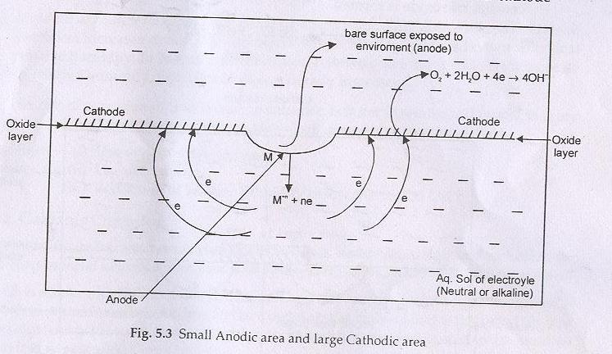
(e)In neutral or alkaline medium in the presence of O₂
O₂ + 2H₂O + 4e- 4OH-
(such type of corrosion involving O₂ is called oxygen type corrosion)

Slide 20
e.g. Rusting of iron occurs by O₂ in the presence of aqueous solution
At anode Fe Fe²+ 2e⁻
At cathode 1/2O₂ + H₂O + 2e⁻ 2OH⁻
Overall reaction Fe + 1/2O₂ + H₂O Fe²⁺ + 2OH⁻ or Fe(OH)₂

Slide 21
(i)In excess supply of oxygen: In excess supply of oxygen, ferrous hydroxide is easily oxidized to ferric hydroxide.
2Fe(OH)₂ + H₂O + 1/2O₂ 2Fe(OH)₃
Fe₂O₃.xH₂O
Yellow rust
(ii) In limited supply of oxygen: In limited supply of oxygen, black magnetite Fe₃O₄ or ferroferric oxide is formed.
Fe(OH)₂ Fe₂O₃.FeO.6H₂O
Black

Slide 22
Wet corrosion Dry corrosion
It takes place in presence of water It takes place in absence of liquid or
or an electrolyte. electrolyte. Gases and vapours are
the corrodants.
It is an electrochemical attack. It is a chemical attack.
It generally takes place at low It takes place at high temperature.
temperature.
It is also known as low It is also known as high
temperature corrosion. temperature corrosion.
It is generally fast. It is generally slow.
Eg. Rusting of iron in water. Eg. Attack of steel furnace by gases at
high temperature.

Slide 23
3) The Acid Theory – applicable particularly to
rusting of iron
2Fe + O₂ + 4CO₂ + 2H₂O 2Fe(HCO₃)₂
2Fe(HCO₃)₂ + H₂O + [O] 2Fe(OH)CO₃+2CO₂+ 2H₂O
2Fe(OH)CO₃ + 2H₂O 2Fe(OH)₃ + 2CO₂

Slide 24
TYPES OF CORROSION
Galvanic corrosion
Erosion corrosion
Crevice corrosion
Pitting corrosion
Differential aeration corrosion

Slide 25
1. Galvanic Corrosion (Bimetallic corroson):
e.g. Zinc and copper couple
More reactive Zn Zn²⁺ + 2e⁻ At anode
(Corrodes)
Less reactive Cu²⁺ + 2e⁻ Cu At Cathode
(protected)

Slide 26
DIFFERENCES BETWEEN ELECTROCHEMICAL SERIES AND GALVANIC SERIES
Electrochemical series | Galvanic series
The arrangement of metals and non-metals in increasing order of their standard reduction potential is known as electrochemical series. .It contains metals and non-metals 3. It is an ideal series 4. ECS is based upon the electrode potential which is determined by using Nernst equation 5. Position of metals is fixed in ECS 6. It gives no idea about the position of alloys 7. It gives information about the relative displacement tendencies | The arrangement of metals and alloys in decreasing order of their corroding tendency in an unpolluted sea water wit is known as galvanic series. 2. It contains metals and alloys. 3. It is a practical series 4. This series is based on actual corrosion rate 5. Position of a given metal in Galvanic series may change 6. It gives clear idea about the position of alloys 7. It gives information about the relative corrosion tendencies

Slide 27
2. Erosion Corrosion:
Due to abrading action of flow of gases or mechanical rubbing action of solids over the metal surface.
3. Crevice Corrosion:
This is accelerated attack at the junction of two metals exposed to corrosive environment.
4. Pitting Corrosion:
Most dangerous form of corrosion as it leads to sudden failure of material due to formation of holes.

Slide 28
Facts about pitting corrosion
Pitting corrosion is autocatalytic, self stimulating and self propagating.
It takes place exclusively in chloride and chloride containing environment.

Slide 29
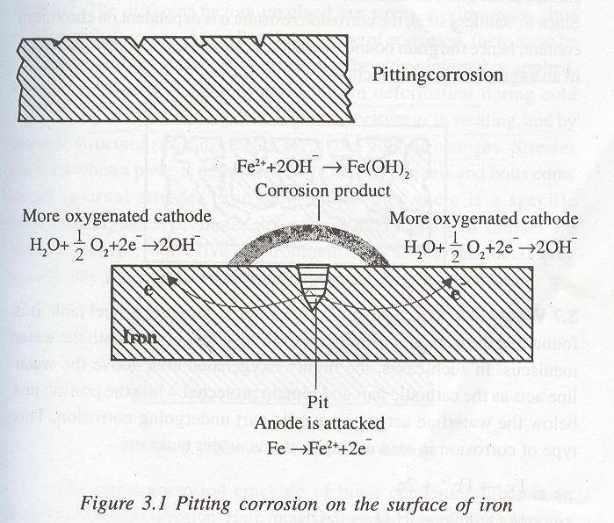

Slide 30
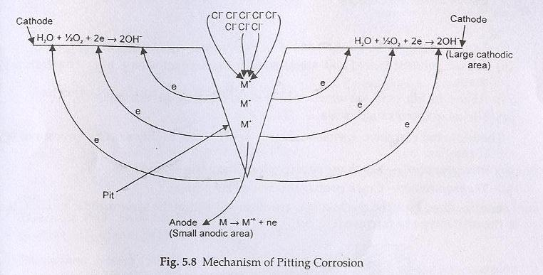

Slide 31
5. Differential aeration Corrosion (Oxygen Concentration Cell Corrosion)
One part of the metal is exposed to a different air/O₂ concentration from the rest of the part.
Portion with lesser O₂ = Anode
Portion with more O₂ = Cathode
e.g. A iron nail inside the wood undergoes corrosion easily

Slide 32
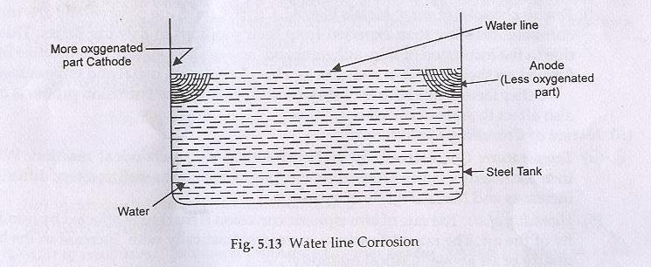
[V] Waterline Corrosion

Slide 33
[VI] Micro-Biological Corrosion :
Due to metabolic activity of various micro-organisms
[VII] Stress-Corrosion Cracking
Metal under stress becomes more anodic and tend to increase the rate of corrosion.
The stress can be due to non-uniform deformation by unequal cooling from high temperature as in welding

Slide 34
Factors affecting chemical corrosion
Nature of the metal
Position in the Galvanic series
Relative areas of anode and cathode
Purity of metal
Solubility of corrosion products
Volatility of corrosion products

Slide 35
(vii) Nature of surface film :
Specific volume ratio = Volume of metal oxide
volume of metal
(viii) Physical state of metal

Slide 36
Nature of environment
Temperature: Rate of chemical reaction and rate of diffusion increases with temperature
Presence of moisture:
Critical humidity is the relative humidity above which the atmospheric corrosion rate of metal increases sharply
Presence of impurities in atmosphere: due to CO₂, H₂S, SO₂ etc in the vicinity of industrial area

Slide 37
(iv) Effect of pH
(v)Nature of ions present: Chloride ions present in the medium destroy the passive film, while silicate in the medium leads to the formation of insoluble film over the metal surface.
Concentration of O₂

Slide 38
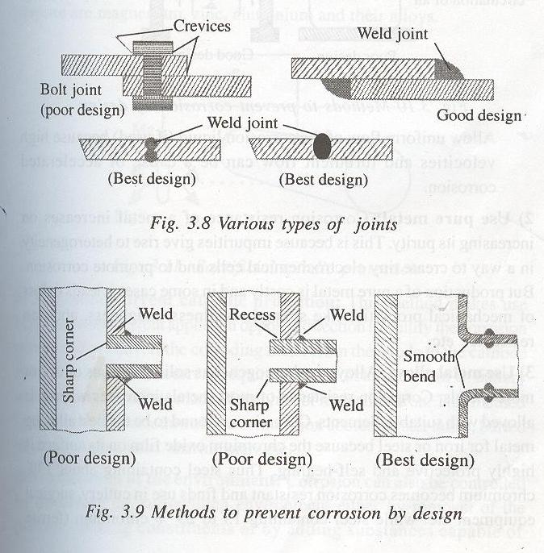
PROTECTION FROM CORROSION
[I] Design and Material Selection

Slide 39
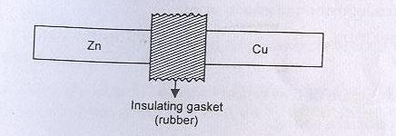
When contact of dissimilar metals is unavoidable, suitable insulator should be inserted between them to reduce current flow and attack on the anode.

Slide 40
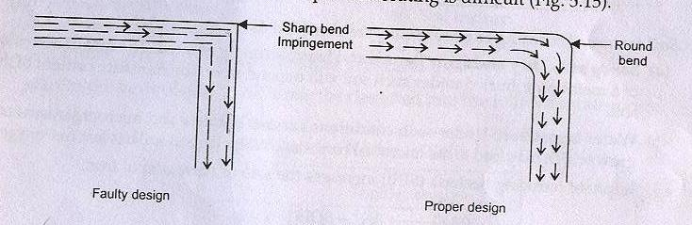

Slide 41
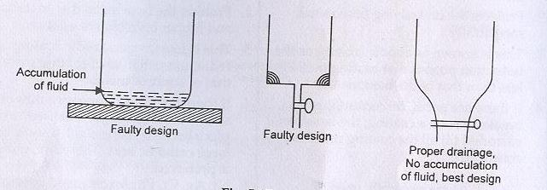

Slide 42
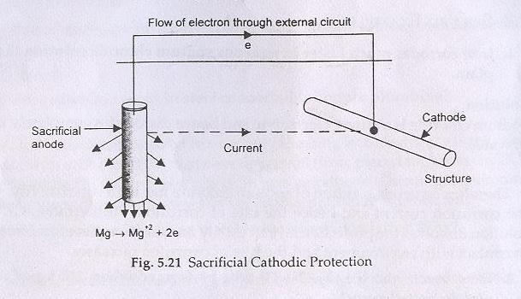
[II] Cathodic Protection
(i) By appropriate galvanic coupling:

Slide 43
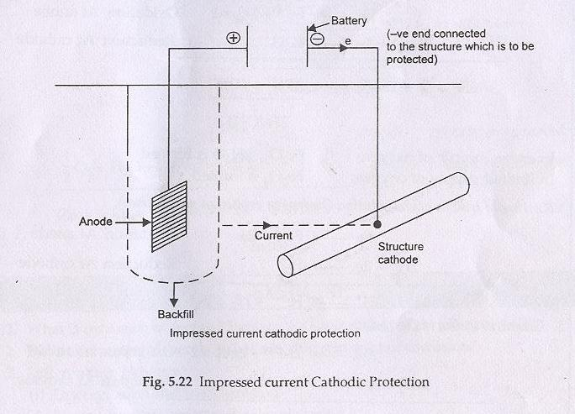
(ii) By impressed current

Slide 44
advantages over sacrificial cathodic protection
It is controlled from outside.
No anode has to be replaced.

Slide 45
[III] Modifying the Environment
Deaeration
Deactivation : addition of chemicals, capable of combining rapidly with O₂ in aqueous solution
Dehumidification: by using alumina or silica gel
Use of inhibitors
a. By forming a layer in between which acts as a barrier between the material and environment.
b. Or by retarding the anodic or cathodic or both processes

Slide 46
4. Metallic coatings
Electroplating
Hot dipping
Metal Cladding
Metal spraying
Cementation: The base metal articles are packed in the powdered coating metal and is heated to a temperature just below the m.p. of more fusible metal, so that an alloy layer is formed over the surface.

Slide 47
